Slide 1

Music Theory Lesson #2 of 5
By Free Knowledge Mission

Slide 2
What We’ll Cover
Check out Andrew Furmanczyk
Music Theory lessons 01 – 50
Lesson 1 covered 01-05
I’ll plan to cover 06…….16
Dotted Notes and Triplets
Time Signatures, Strong and Weak Beats
Semi Tones & Whole Tones
Chromatic/Diatonic, Enharmonic Tones
Major Scale
Minor Scale (Natural & Harmonic) Melodic +
Relative Minor
Order of Sharps and Flats + Key Signatures
Circle of Fifths
Basic Intervals

Slide 3
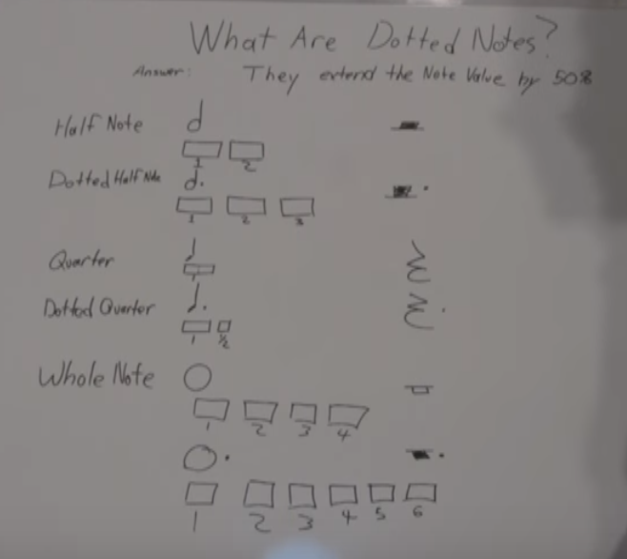
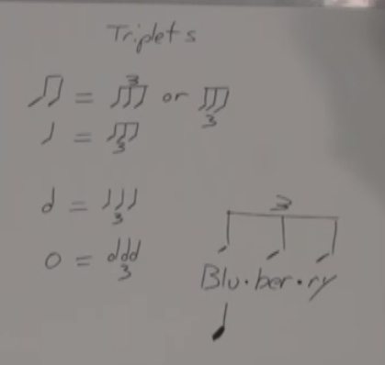
#6 Dotted Notes & Triplets

Slide 4
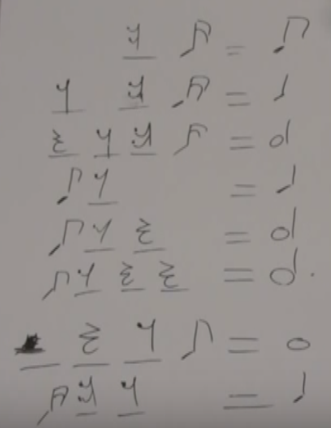
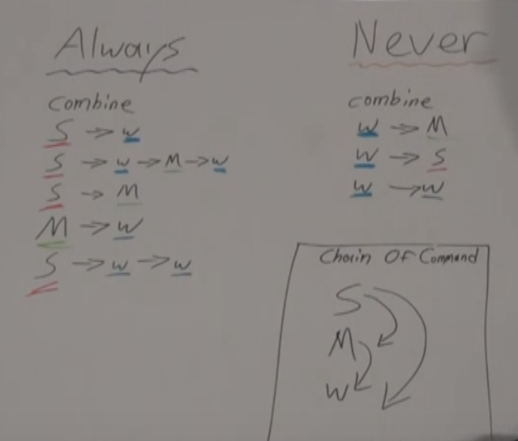
#7 Completing Bars, Strong & Weak Beats

Slide 5
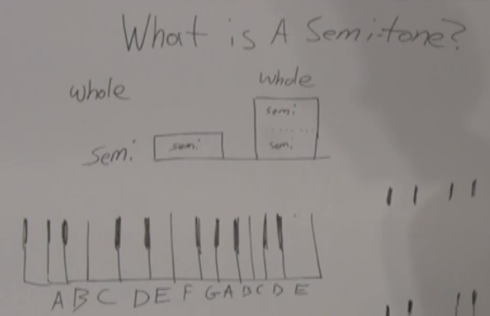
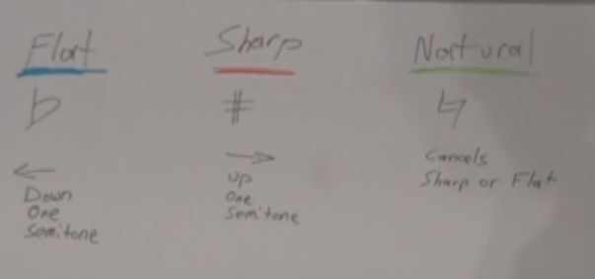
#8 Semi Tones & Whole Tones

Slide 6
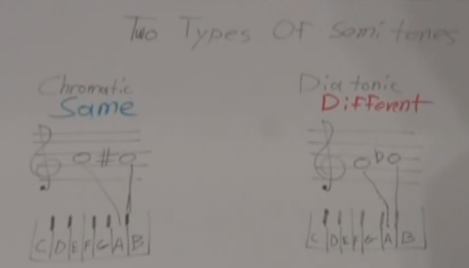
#9 Chromatic/Diatonic Enharmonic Tones

Slide 7
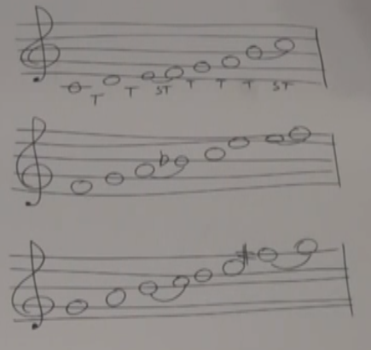
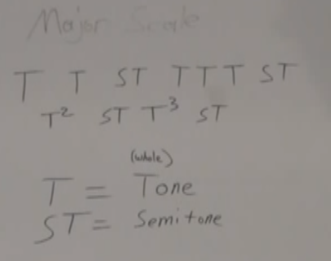
#10 Major Scale

Slide 8
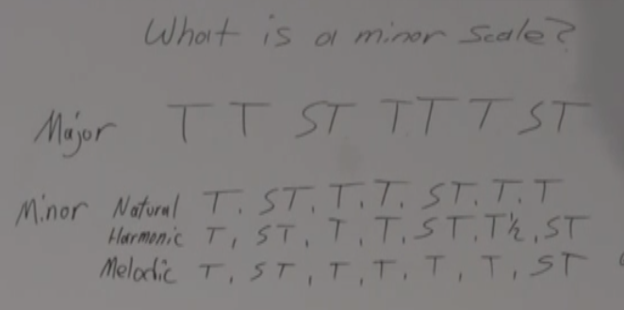
#11 Minor Scale (Natural & Harmonic) Melodic + Relative Minor

Slide 9
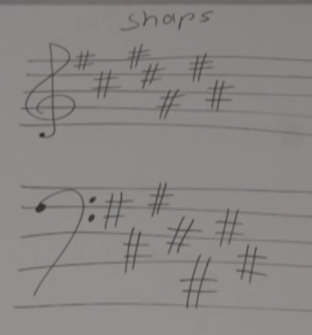
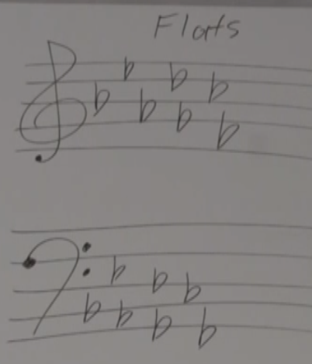
#12 Order of Sharps and Flats + Key Signatures
Order
Sharps # Father Charles Goes Down And Ends Battle
Flats b Battle Ends And Down Goes Charles Father

Slide 10
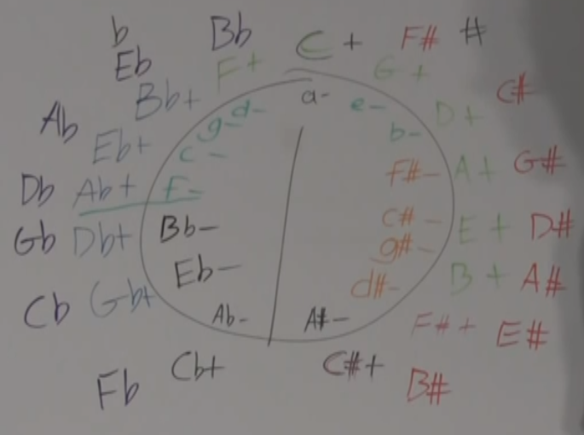
#13 Circle of Fifths

Slide 11
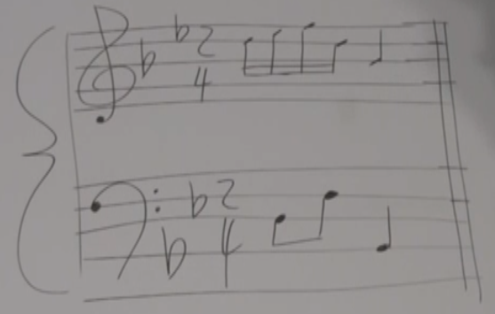
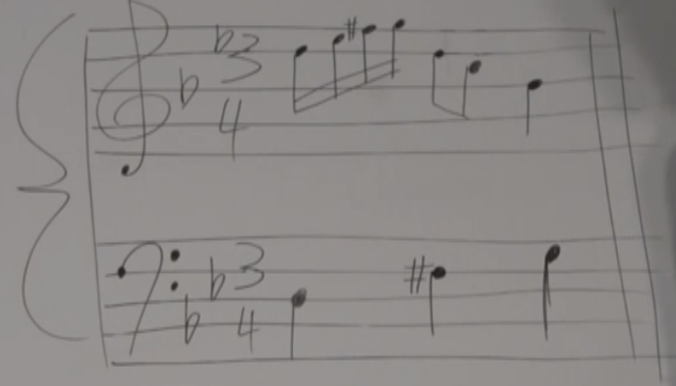
#14 Key of Music

Slide 12
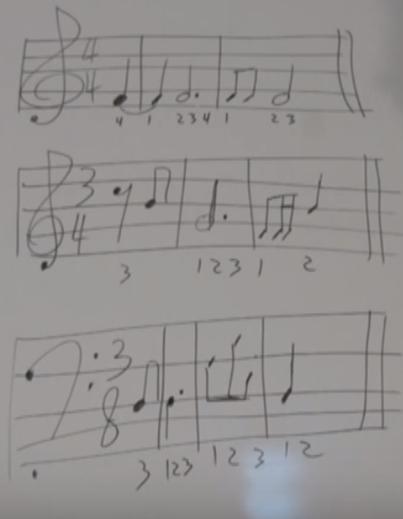
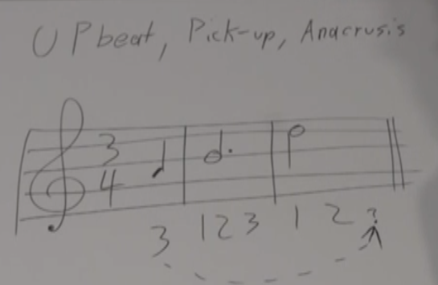
#15 Upbeat or Pickup Beat

Slide 13
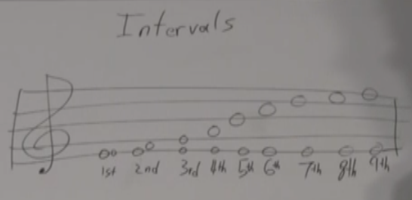
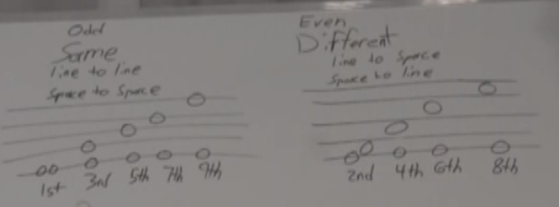
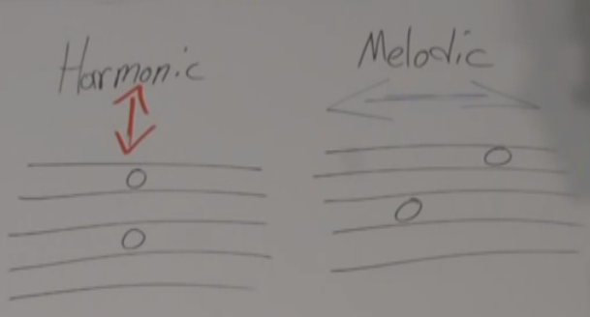
#16 Basic Intervals

Slide 14
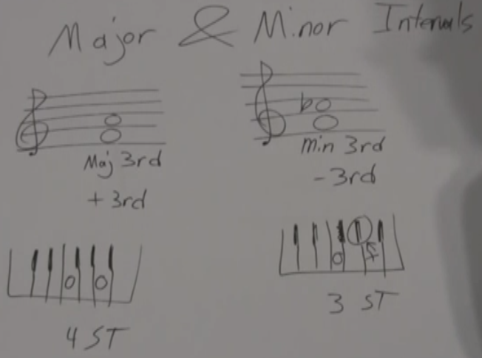
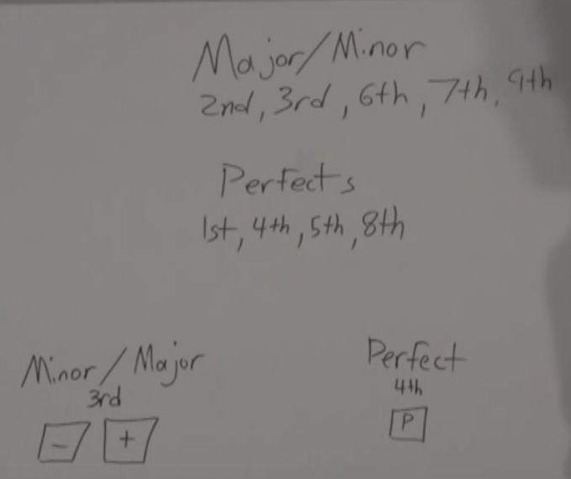
#17 Intermediate Intervals

Slide 15
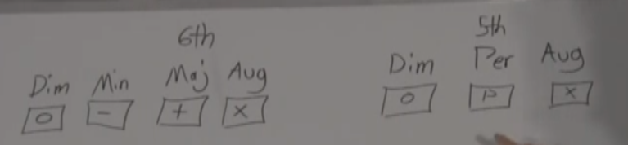
#18 Advanced Intervals

Slide 16
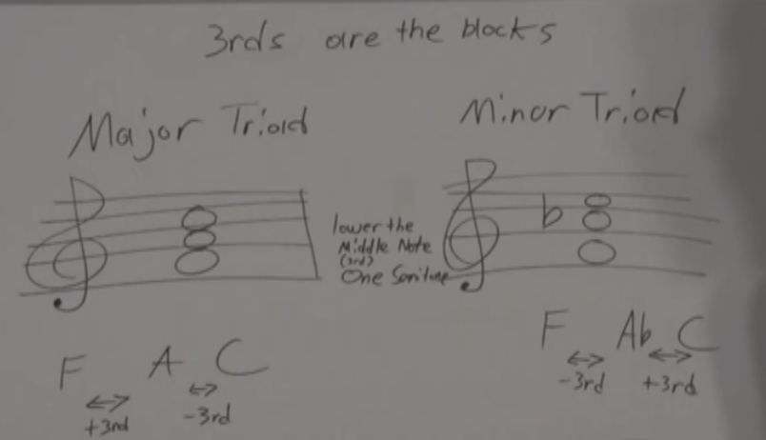
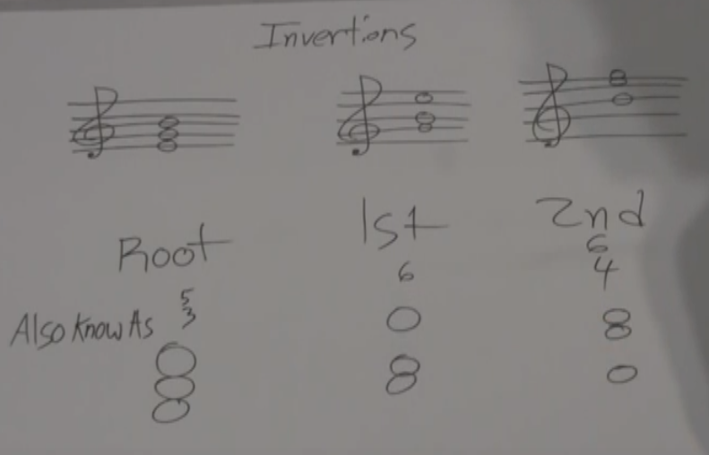
#19 Major and Minor Triads

Slide 17
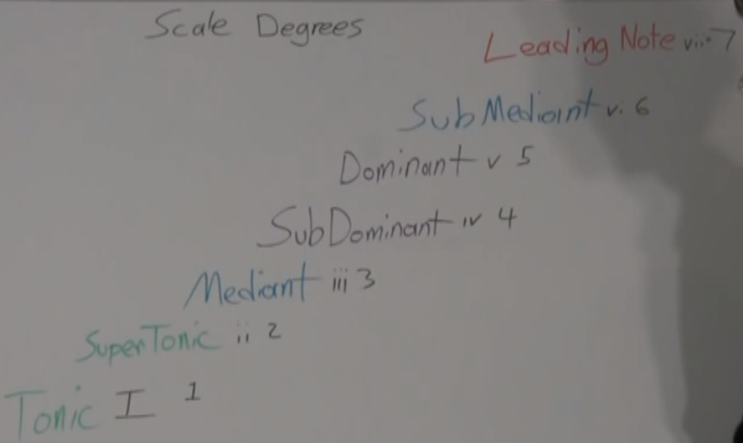
#20 Scale Degrees

Slide 18
Practice
Watch all 15 videos
Repeat the lessons many times; especially the ones you don’t understand.
Write them out. Practice the lessons Andrew provides.

Slide 19
Resources
Lypur – Andrew Furmanczyk
Notes and Slides

Slide 20


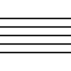
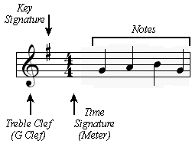
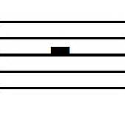
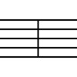
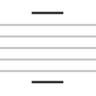


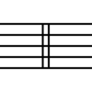
Legend #1

Slide 21
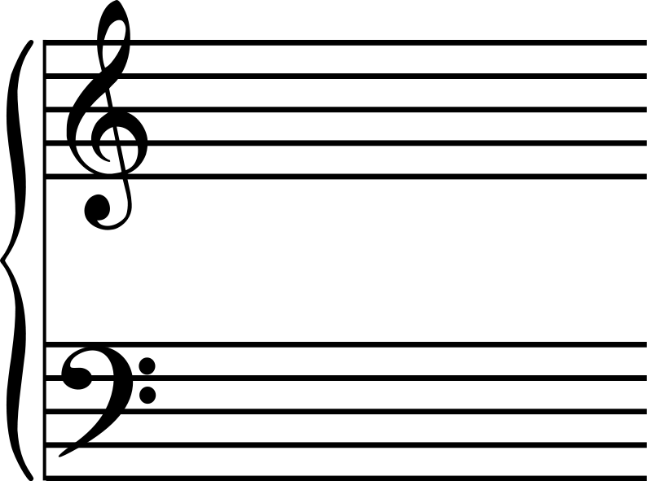
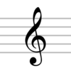
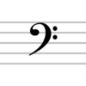






Legend #2

